Slide 1
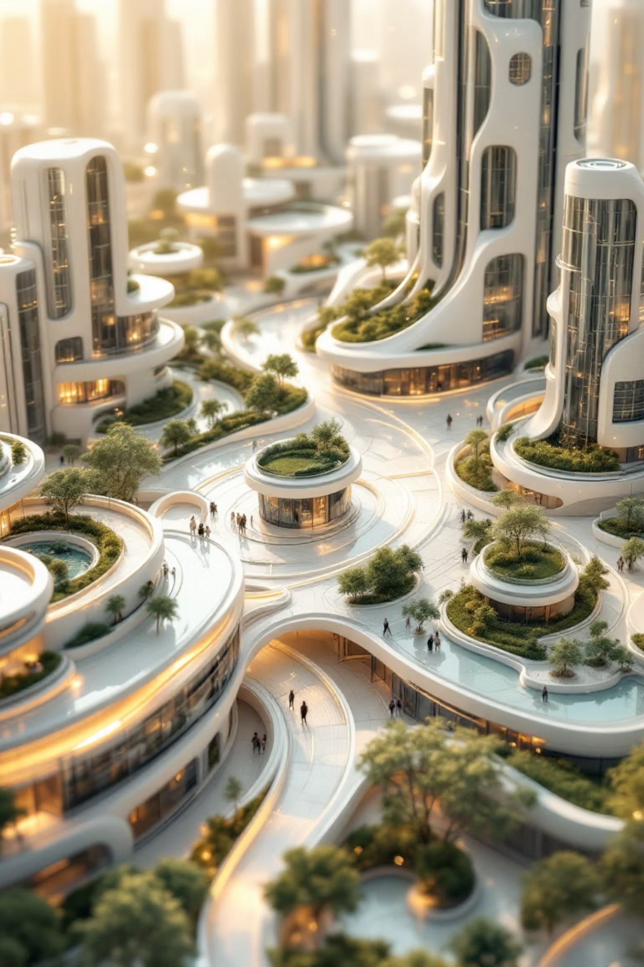
Data Pathways to Healthy Cities and Human Settlements
Problem → Innovation → Implementation → Impact
This presentation outlines a framework for leveraging data and technology to create healthier, more sustainable urban environments. We'll explore the challenges, innovative solutions, implementation strategies, and the profound impact on human settlement can achieve.

Slide 2
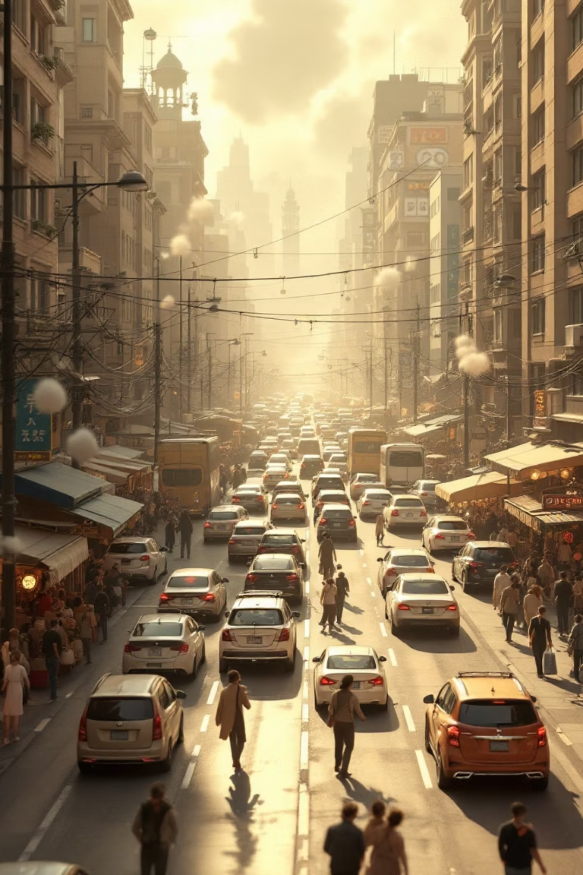
problem faced:
Rapid Urbanisation & Disease:
Increase global warming:
Over 50% of the global population resides in cities, grappling with a surge in non-communicable diseases (NCDs) and escalating environmental hazards.
Fossil fuel burning (coal, oil, gas) → CO₂ emissions
Deforestation → less CO₂ absorption
Urbanization → heat islands, reduced green cover
Preventable Deaths:
Loss of Green Cover:
Road traffic injuries, pervasive pollution, and food deserts contribute to an alarming 47 million deaths annually, as reported by the World Health Organisation (WHO).
Loss of green cover means deforestation, urbanization, and degradation of natural vegetation, which reduces the number of trees and plants in an area.

Slide 3


creative approach
Tree Plantation: Number of trees needed to plant
Climate Data: Historical & current climate trends, seasonal changes.
Weather Forecast: Real-time weather updates for cities/states.
Air Quality Index (AQI): Pollution levels and alerts
our webpage is creative, highly interactive and colourful with images, and map

Slide 4



Innovation: Smart Data Integration Platform
Imagine a unified system that transforms disparate data into actionable insights for healthier cities.
the increasing population may cause high amount of pollution. we can detect it through our website.
our website provide information about the Climate, Pollution, etc
our webpage shows the Green score of the location with using map

Slide 5
Impact & Solutions
Our project can follow these key steps to create tangible solutions for urban health.
01
02
Raising Awareness
Encouraging Citizen Action
Citizens can see state-wise tree cover, climate trends, and pollution levels.
Users can participate in tree plantation drives.
Gamified challenges incentivize eco-friendly behaviour.
Interactive visuals make data easy to understand and memorable.
03
04
Supporting Policy & Planning
Promoting Healthy Cities
Planners and NGOs can access real-time, data-driven insights.
Better green cover → lower urban heat, improved air quality, and enhanced mental health.
Helps in planning green zones, urban forests, and climate mitigation projects.

Slide 6

Let’s Build Healthy Cities Together!
Increase Green Cover
decreasing water, noise, air pollution
Climate & Weather Awareness
thank you!!

